Slide 1
MACHINE LEARNING ALGORITHMS · LECTURE 1
Simple Linear Regression: Building the Intuition
Why this is the first algorithm every ML learner should master, and the geometric idea behind it — before any of the math
Machine Learning • Regression Series

Slide 2
WHY THIS ALGORITHM
Why Begin an ML Journey With Linear Regression?
Every course, every textbook, starts the same way — and that's not an accident.
It's genuinely simple
Easy to understand, easy to explain — unlike black-box algorithms (SVM, PCA) where even practitioners struggle to say exactly what's happening inside.
It's interpretable
You can look at what the model learned and explain it in plain language — a rare property among ML algorithms.
It's foundational
Everything you learn here — best-fit lines, minimizing error — carries forward and compounds as you move to more advanced algorithms.
Simple Linear Regression — Building Intuition
2

Slide 3
THE LANDSCAPE
Where Linear Regression Fits
Machine Learning splits first into Supervised, Unsupervised, and Semi-Supervised learning. Supervised learning splits again into two problem types:
Regression
Classification
Output column is numerical / continuous — a package in LPA, a house price, a temperature.
Output column is categorical — spam or not spam, pass or fail, which of several classes.
← Linear Regression lives here
Different algorithms, different lecture
Linear Regression is a Supervised Machine Learning algorithm that solves Regression problems — the moment you see a numeric output column, this family of algorithms is in play.
Simple Linear Regression — Building Intuition
3

Slide 4
THE LANDSCAPE
Three Flavors of Linear Regression
This is the full map of what "Linear Regression" covers as a topic — we'll work through all three, in order.
1
Simple Linear Regression
One input column, one output column. Today's entire focus.
2
Multiple Linear Regression
More than one input column feeding a single output.
3
Regularized Regression
Ridge, Lasso and similar variants — built on the same foundation, with extra constraints.
Master Simple Linear Regression deeply, and Multiple Linear Regression will feel like a small, natural extension — not a new topic.
Simple Linear Regression — Building Intuition
4

Slide 5
DEFINITIONS
"Simple" vs. "Multiple" — One Word Makes the Difference
SIMPLE LINEAR REGRESSION
MULTIPLE LINEAR REGRESSION
Exactly one input column,
one output column
More than one input column,
one output column
Input: CGPA
Input: CGPA, gender,
12th %, state
Output: Package (LPA)
Output: Package (LPA)
"Given a student's CGPA, predict their package."
"Given several facts about a student, predict their package."
Our focus for the rest of this lecture
Covered in a later lecture
Simple Linear Regression — Building Intuition
5

Slide 6
TODAY'S PLAN
What This Lecture Covers
1
2
The problem
The geometric idea
A concrete placement dataset, and why you can't just guess
Plotting the data and discovering the best-fit line, by eye
3
4
Hands-on with code
Human intuition
Training scikit-learn's LinearRegression and reading its predictions
What the slope and intercept actually mean, in plain language
The full math derivation — deriving m and b from scratch, and building your own LinearRegression class — is next lecture. Today is intuition-first.
Simple Linear Regression — Building Intuition
6

Slide 7
THE PROBLEM
The Placement Prediction Problem
A college has 4th-year students who have been placed. For each, we know two things: their CGPA, and the package (in LPA) they were offered.
The goal
Build a model — imagine it as a simple website — where a new student enters their CGPA, and instantly gets a predicted package. Under the hood, that website just needs a working Linear Regression model.
The starting question: imagine you had zero data at all. If a student asked "what package will I get?", could you answer meaningfully? No — with nothing to go on, any answer is a guess.
So the real question becomes: once you do have data, how do you use it well?
Simple Linear Regression — Building Intuition
7

Slide 8
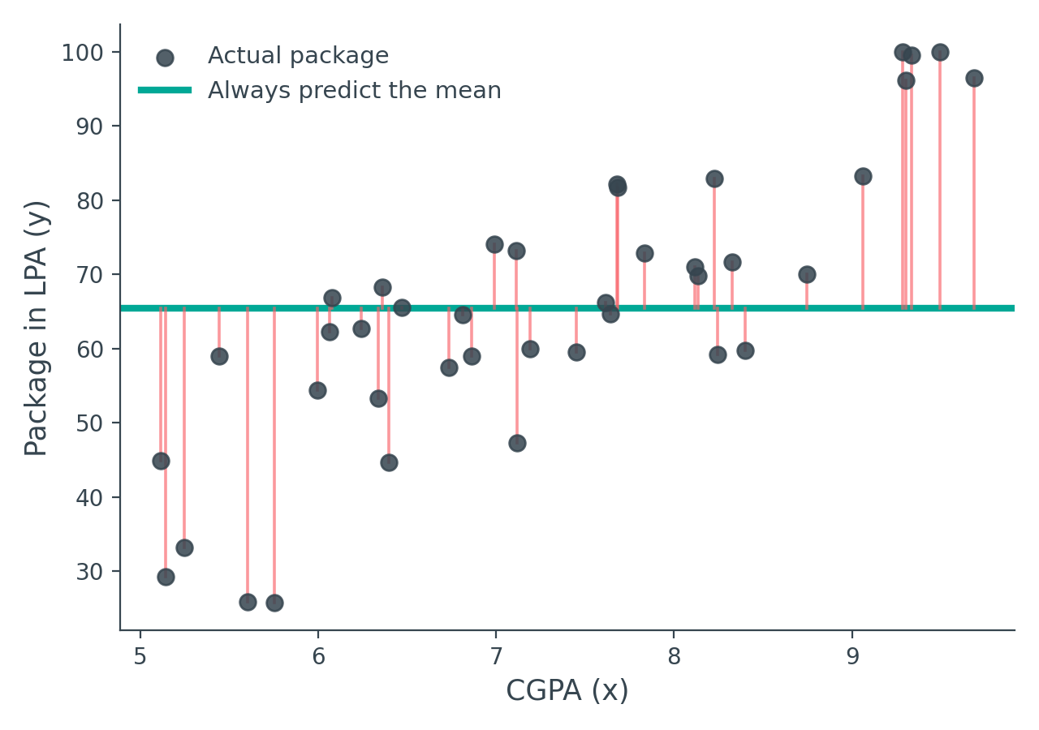
A NAIVE ATTEMPT
The Simplest Possible Idea: Just Guess the Mean
With data available but no model, one option: take the mean package of every placed student, and always answer with that number.
Why this fails
A student with a strong CGPA and a student with a weak CGPA both get the exact same predicted package — every red gap on this chart is a mistake this approach makes.
The CGPA column exists precisely because it should influence the prediction. Ignoring it wastes the most useful information you have.
Simple Linear Regression — Building Intuition
8

Slide 9
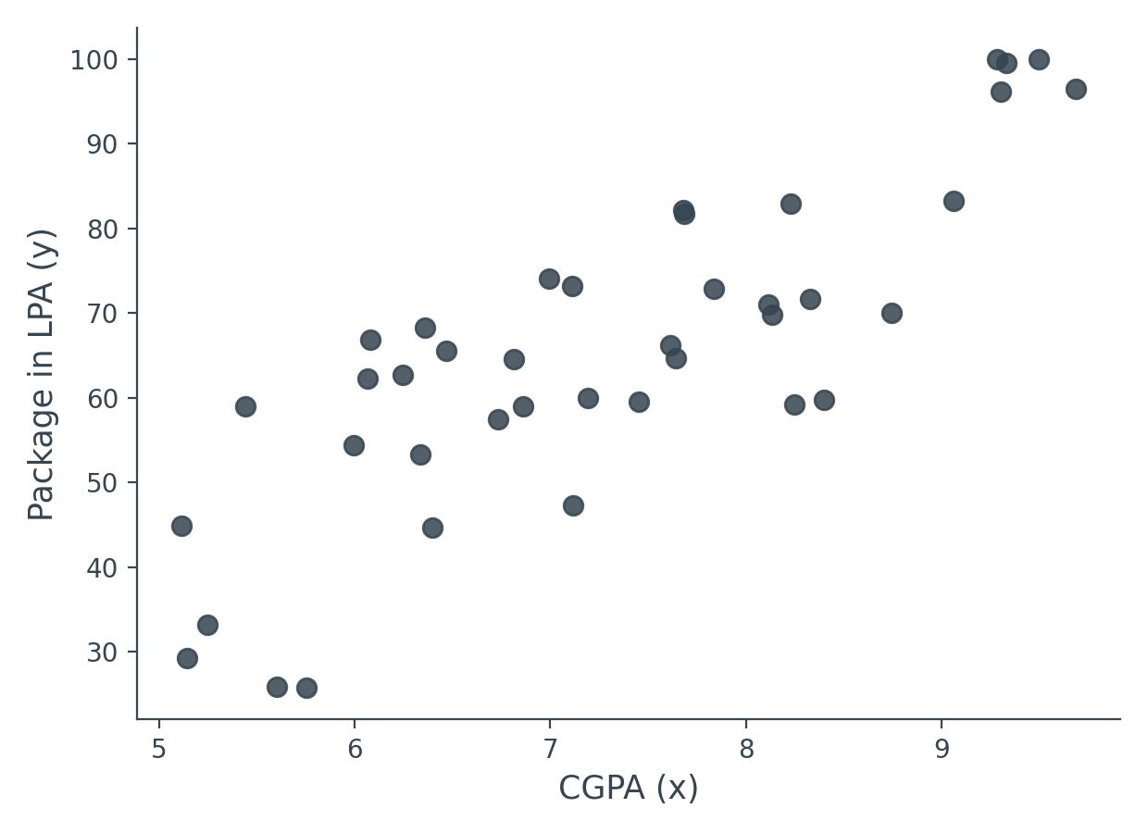
A BETTER IDEA
Step One: Just Look at the Data
Before building anything, plot CGPA against package for every student. A picture reveals structure a table of numbers hides.
Simple Linear Regression — Building Intuition
9

Slide 10
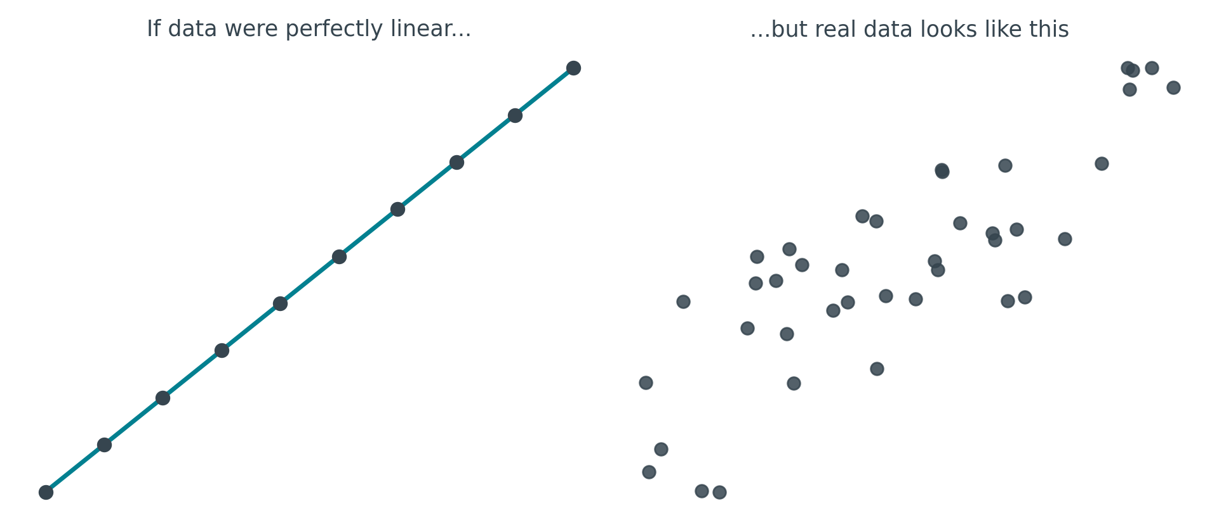
KEY OBSERVATION
The Data Is "Sort Of" Linear
As CGPA goes up, package tends to go up too — but the points don't sit on a single, perfect line. There's a clear trend, wrapped in noise.
This gap between "perfectly linear" and "real" is the whole reason Simple Linear Regression needs a clever idea, not just an equation.
Simple Linear Regression — Building Intuition
10

Slide 11
WHY THE NOISE?
Why Isn't Real Data Perfectly Linear?
Real-world outcomes carry real-world randomness — factors no formula can capture from a spreadsheet of just two columns.
A weaker CGPA, but a great package
Maybe the interview went unusually well, or a personal connection helped, or the hiring company was simply paying generously that year.
A strong CGPA, but a disappointing package
Maybe the interview didn't go well that day, or the specific company or role just paid less, regardless of academic record.
None of this is something we can quantify or put a number on — it's exactly the kind of unpredictable human and situational noise that real datasets carry.
Simple Linear Regression — Building Intuition
11

Slide 12
A THOUGHT EXPERIMENT
If the Data Really Were Perfectly Linear...
...the problem would be almost trivial. Draw one line that passes through every single point, and you're done.
1
2
3
Find the line's equation
Know m and b
Predict anything instantly
Every straight line can be written as y = mx + b
Once you have both numbers, the line is fully defined
Plug in any new CGPA (x), and y falls straight out
y = mx + b — m = slope, b = intercept
But our data isn't perfectly linear — so no single line passes through every point. We need a different plan.
Simple Linear Regression — Building Intuition
12

Slide 13
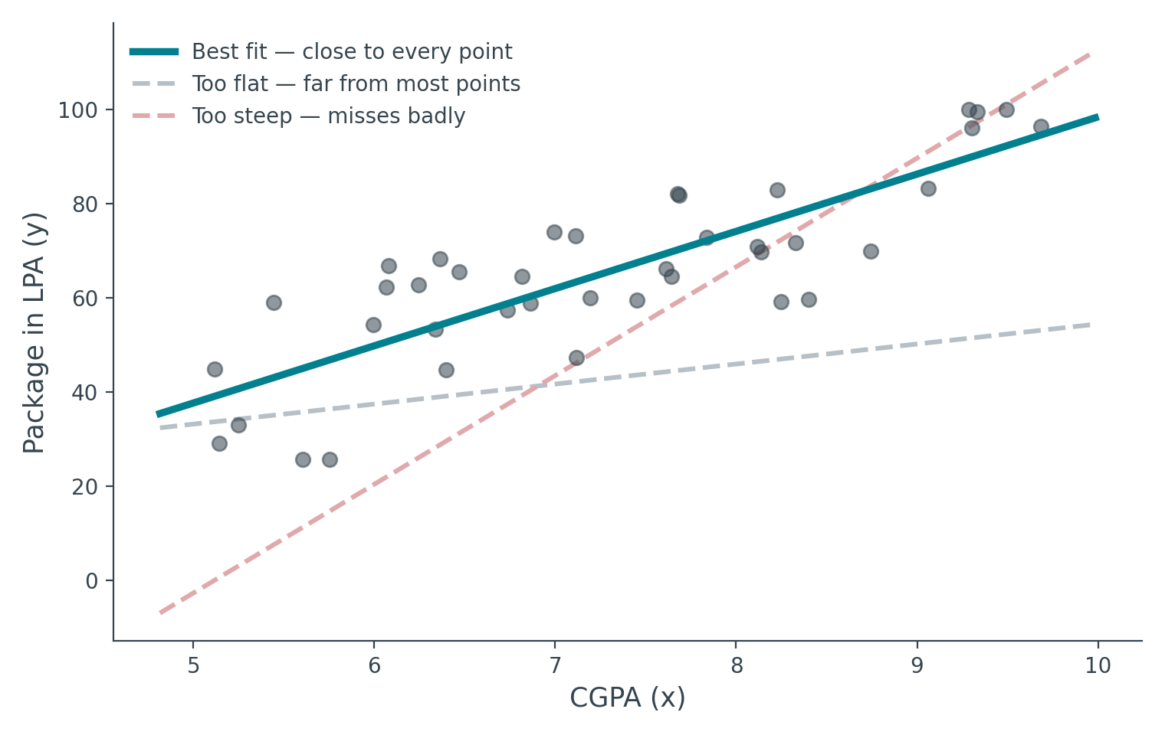
THE CORE IDEA
Since No Line Is Perfect — Find the Best One
Draw a line that passes as close as possible to every point, even though it touches almost none of them exactly. This is called the best-fit line.
Simple Linear Regression — Building Intuition
13

Slide 14
THE CORE DEFINITION
Simple Linear Regression, In One Sentence
An algorithm whose entire job is to find the best-fit line
on a scatter of two-dimensional data.
That's it. Every formula, every derivation, every line of sklearn code that follows exists purely to answer one question: which m and which b make the best line?
Simple Linear Regression — Building Intuition
14

Slide 15
A PREVIEW
The Math Is Coming — Just Not Yet
Working out exactly how m and b get calculated requires real derivation — and that's the entire subject of the next lecture, where we build it from scratch.
Today's approach instead
Use scikit-learn's ready-made LinearRegression to see the algorithm work end-to-end, build a feel for what a "trained model" actually is, and develop plain-language intuition for what its output numbers mean — before opening up the math.
Why this order works well: code-first learners (which most ML students are) often find the math far easier to absorb once they've already seen it "do something" real.
Simple Linear Regression — Building Intuition
15

Slide 16
HANDS-ON
The Standard Workflow for Any ML Algorithm
Before touching Linear Regression specifically, here's the four-step pattern every supervised algorithm follows:
1
Extract X and y
2
Train-test split
Separate the input column(s) from the output column
Hold out some rows to check honestly how well the model does later
3
Select and train
4
Predict
Choose the algorithm class, then fit it on the training data
Feed new inputs through the trained model to get outputs
Simple Linear Regression — Building Intuition
16

Slide 17
IMPLEMENTATION
Step 1–2: Extract Columns, Then Split
df = pd.read_csv('placement.csv')
X = df.iloc[:, 0] # CGPA — all rows, column 0
y = df.iloc[:, -1] # Package — all rows, last column
X_train, X_test, y_train, y_test = train_test_split(
X, y, test_size=0.2, random_state=2
)
test_size=0.2
random_state=2
20% of rows set aside purely for honest evaluation later
Fixes the random shuffle, so results are reproducible run to run
Simple Linear Regression — Building Intuition
17

Slide 18
IMPLEMENTATION
Step 3: Select the Algorithm and Train It
from sklearn.linear_model import LinearRegression
lr = LinearRegression()
lr.fit(X_train, y_train)
That's genuinely all it takes. Create the model object, call .fit() with the training data, and — because this dataset is small — training finishes almost instantly. The model is now "trained," meaning it has learned its own m and b internally.
A model that hasn't been trained yet has no m or b at all — fit() is the step where those numbers actually get computed.
Simple Linear Regression — Building Intuition
18

Slide 19
IMPLEMENTATION
A Common Snag: The Reshape Gotcha
Passing a single test value directly into predict() often throws a shape error — here's why, and the one-line fix.
What sklearn expects
What a single value looks like
A 2D array — shaped like a column, even for one feature and one row.
Just a bare scalar — sklearn can't tell how many features or rows that represents.
shape = (1, 1)
shape = ()
lr.predict([[8.58]]) # nested brackets → one row, one column
A small detail, but one nearly every learner hits on their first prediction — worth knowing before it trips you up.
Simple Linear Regression — Building Intuition
19

Slide 20
IMPLEMENTATION
Step 4: Predict, and Compare to Reality
Run the trained model on a couple of test students, and check the predicted package against what they actually got.
CGPA
Actual package
Predicted
Student A
8.58
4.10 LPA
≈ 3.90 LPA
close, not exact
Student B
7.15
3.49 LPA
≈ 3.25 LPA
close, not exact
Predictions land close to reality but not exactly on it — expected, since our data isn't perfectly linear. That gap is the residual we'll formalize mathematically next lecture.
Simple Linear Regression — Building Intuition
20

Slide 21
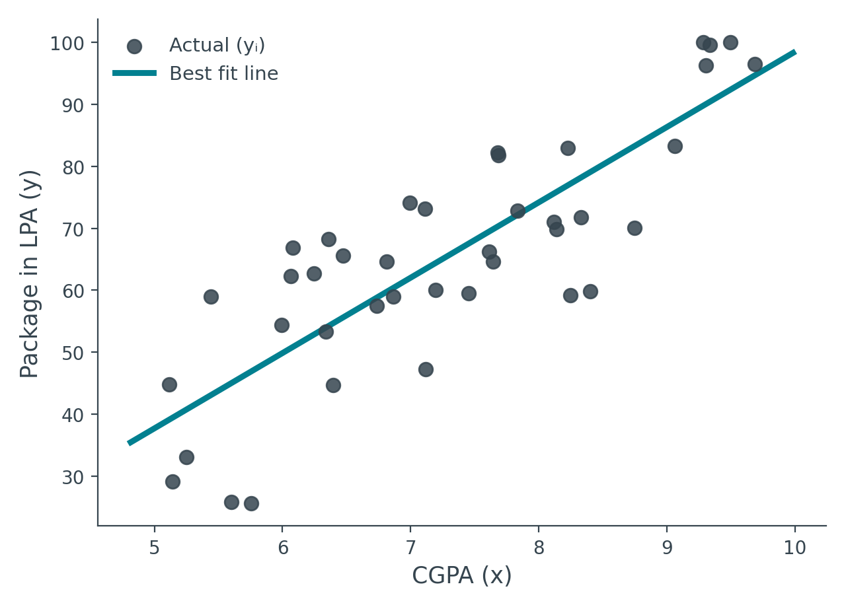
VISUALIZING THE RESULT
What the Algorithm Actually Drew
Overlay the trained model's line on top of the full scatter plot — this is the literal best-fit line the algorithm found for our data.
Simple Linear Regression — Building Intuition
21

Slide 22
IMPLEMENTATION
Reading the Line's Equation Straight From the Model
Every trained scikit-learn LinearRegression stores its learned slope and intercept as attributes — no need to reverse-engineer them.
lr.coef_ # the slope, m
lr.intercept_ # the intercept, b
# manual check: y = m * x + b
m * 8.58 + b # should match lr.predict([[8.58]])
Confirmed: computing y = mx + b by hand, using the values read from coef_ and intercept_, produces exactly the same number as lr.predict() — proof that predict() is doing nothing more mysterious than plugging into the line's own equation.
Simple Linear Regression — Building Intuition
22

Slide 23
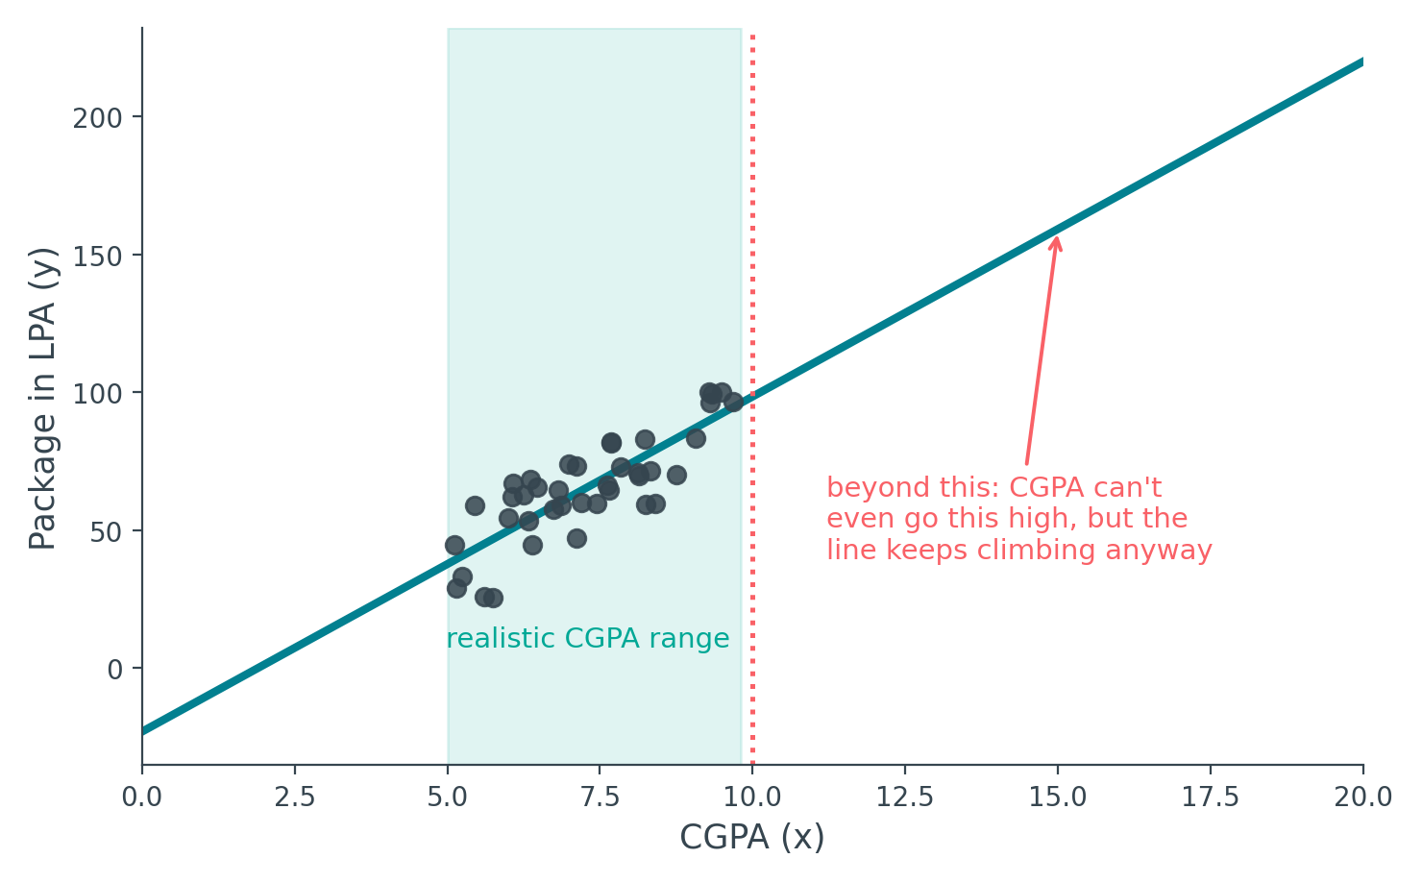
A REAL LIMITATION
The Line Doesn't Know Where to Stop
Push the input far outside the range the model was trained on, and it keeps predicting anyway — following the line blindly, with no sense of real-world limits.
Simple Linear Regression — Building Intuition
23

Slide 24
HUMAN INTUITION
Beyond the Math: What Do m and b Actually Mean?
Mathematically, the story is simple: package = m × CGPA + b.
But if you had to explain that equation to someone with no math background — what would you actually say m and b represent?
package = m × CGPA + b
Simple Linear Regression — Building Intuition
24

Slide 25
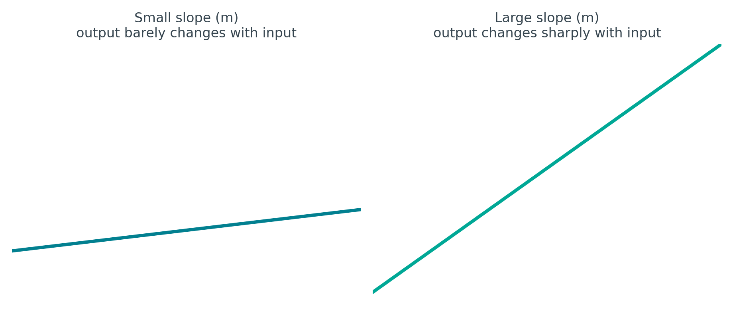
HUMAN INTUITION
m — How Strongly the Output Depends on the Input
Think of m as importance, or weightage. A small m means small changes in output for even large changes in CGPA — package barely depends on it. A large m means package swings sharply with even a small CGPA change — the input matters a lot.
This is exactly why, in ML terminology, m is often just called a "weight."
Simple Linear Regression — Building Intuition
25

Slide 26
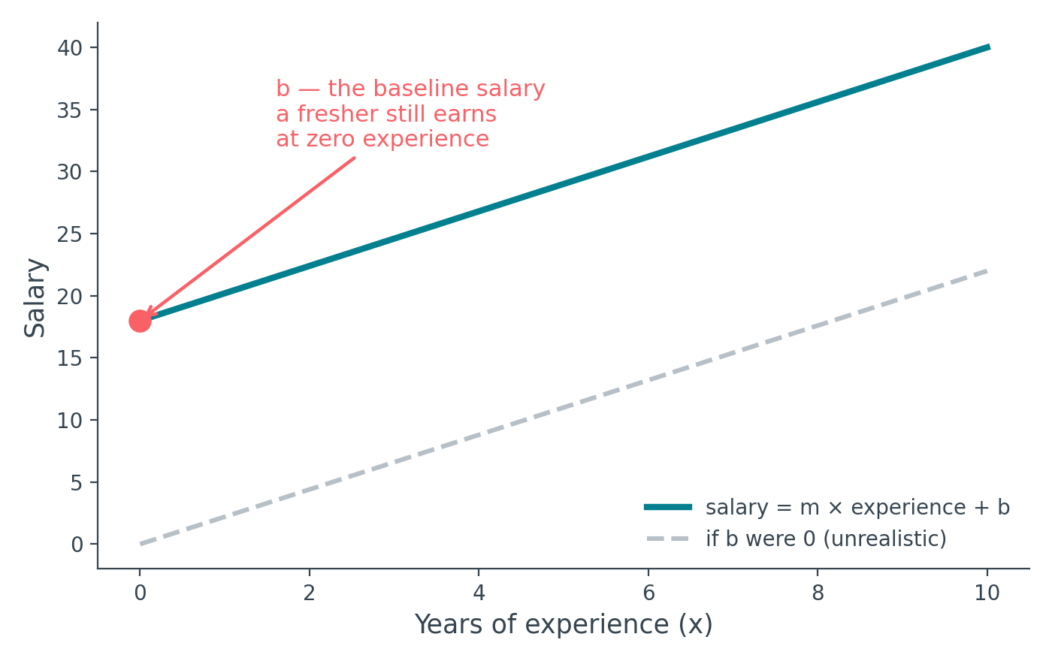
HUMAN INTUITION
b — The Value That Exists Even Without the Input
Try setting b = 0 for our example: package = m × CGPA. At CGPA = 0, predicted package is exactly 0 — plausible enough here, but it doesn't reveal what b really means. A different example makes it clearer:
Simple Linear Regression — Building Intuition
26

Slide 27
HUMAN INTUITION
Why a Fresher's Salary Isn't Zero
Swap the example to years of experience → salary. If b were forced to 0, a fresh graduate with zero experience would be predicted a salary of exactly zero — which is obviously wrong. Companies pay a base salary regardless.
b represents the baseline value of the output —
what it would be even if the input column didn't move the needle at all.
For the placement example, b captures whatever floor value package tends toward, independent of CGPA — the part of the outcome the input feature alone doesn't explain.
Simple Linear Regression — Building Intuition
27

Slide 28
RECAP
Putting m and b Together
•
Output depends on input, through m
The larger the weight, the more strongly the output tracks the input's changes.
•
Output has a baseline, through b
Even if the input column vanished entirely, the output wouldn't collapse to zero — b is what's left over.
•
Together, they define the line
Every prediction the model makes is just this pair of numbers, applied to a new input.
Simple Linear Regression — Building Intuition
28

Slide 29
KEY TAKEAWAYS
What We Covered Today
Why start here
Linear Regression is simple, interpretable, and foundational for everything that follows.
The core idea
Simple Linear Regression finds the best-fit line on a 2D scatter of real, noisy data.
The workflow
Extract X/y, split train/test, fit the model, predict — the same four steps every algorithm follows.
The intuition
m is the weight — how strongly output tracks input. b is the baseline — what remains when input doesn't move.
A real limitation
The line extrapolates blindly beyond the data it was trained on — no built-in sense of realistic bounds.
Next lecture: the complete mathematical derivation of m and b — and building your own LinearRegression class from scratch.

